Slide 1
Improving Loan Recommendation System from Bankrate
Xavier Zuo

Slide 2
Outline
Goal of loan data from Bankrate
Reasons for seeking loan
Market segments
Recommendations

Slide 3
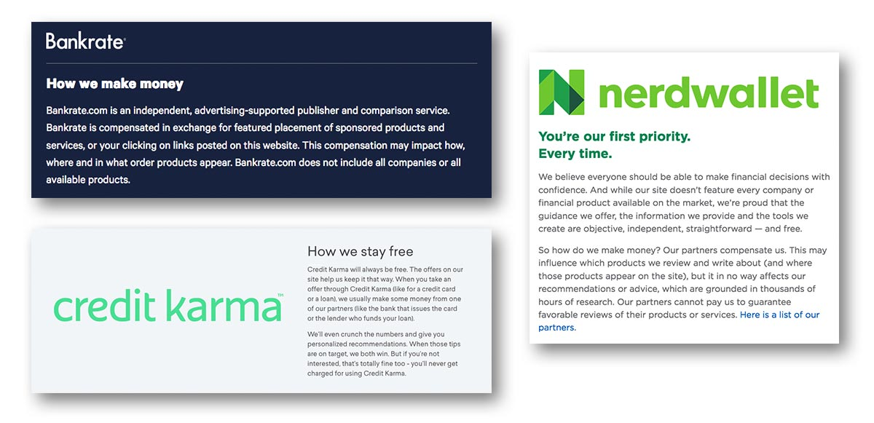
Data Aggregator

Slide 4
Goal of Dataset
100,000 visitors applied for private loan with one of three lenders through Bankrate
Connect customers to right lenders
Improve approval rate
Improve commission

Slide 5
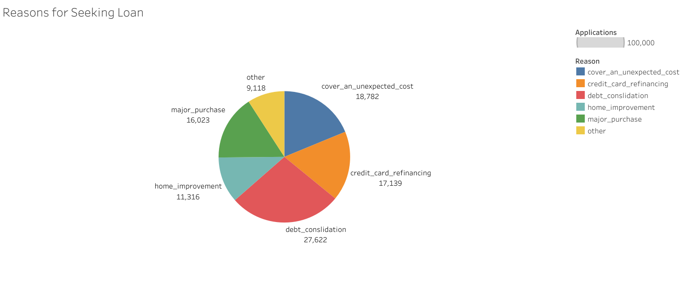
Reasons
44% - debt consolidation or CC financing

Slide 6
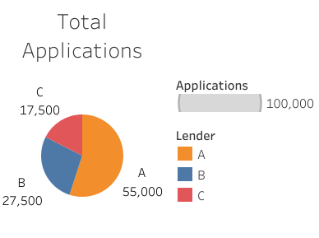
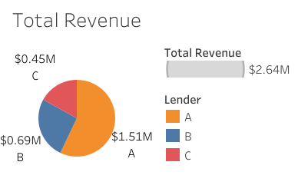
Loan Applications

Slide 7
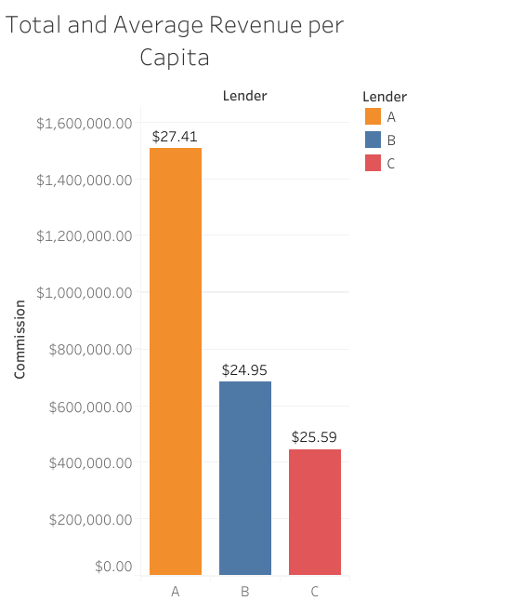
Loan Data
Commission
Lender A: $250
Lender B: $350
Lender C: $150
Total Revenue: ~ $2.5 MM
50% revenue from Lender A

Slide 8
Market Segmentation
Inefficiency in current recommendation system
Find customers with low loan approval and poor revenue generation
Redirect toward another lender

Slide 9
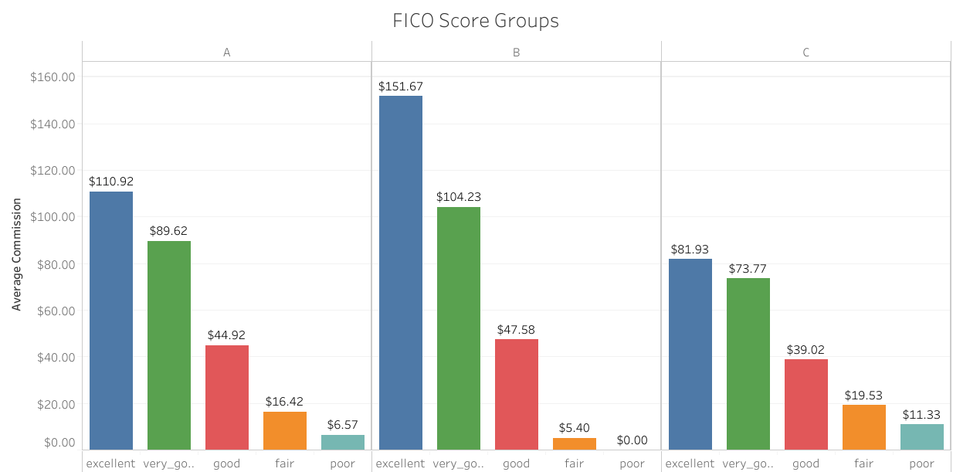
FICO Score is Key

Slide 10
FICO Score is Key

Slide 11
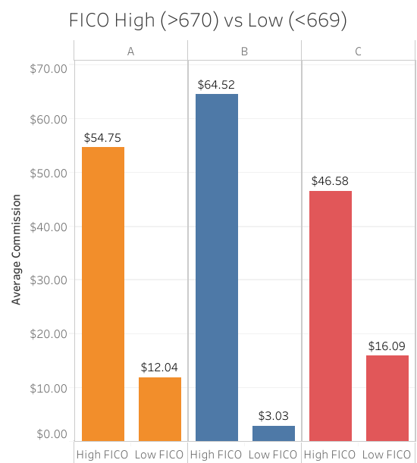
FICO Binary
Lender B
FICO 670-850
Lender C
FICO 300-669
Lender A
Non-selective

Slide 12
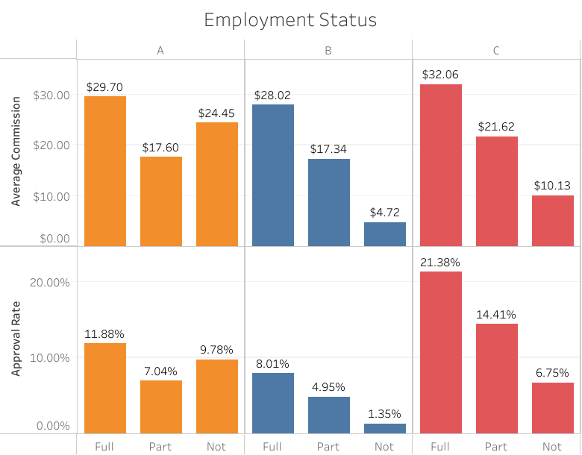
Lender A and Unemployment

Slide 13
Lender A
Important resource for unemployed
US Credit Card debt 2023 – over $1 trillion*
Average credit card balance – $7,279*
Credit Card Interest Rate – 20%+*
Personal Loan Interest Rate – less than 10%*
*Lending Tree Credit Card Statistics

Slide 14
Summary
Dataset of 100,000 people seeking private loan
Used segmentation analysis to identify improvements
3 Key Recommendations:
Lender A: Unemployed
Lender B: Employed with High FICO (670+)
Lender C: Employed with Low FICO (<670)

Slide 15
Questions

Slide 16
References
Public Tableau
https://public.tableau.com/app/profile/xavier.zuo/viz/BankrateRecommendation/EmploymentStatus
Lending Tree Credit Card Statistics
https://www.lendingtree.com/credit-cards/credit-card-debt-statistics/

